Slide 1
Analyzing Points of Interest (POIs) in New York City: A Geospatial Data Analysis

Slide 2
Introduction
Project overview and objectives: The objective of this project is to conduct a geospatial data analysis of Points of Interest (POIs) in New York City. By leveraging GIS data and statistical analysis, we aim to gain insights into the demographic characteristics and spatial distribution of various POI types.
Importance of geospatial analysis for understanding urban demographics: Geospatial analysis provides valuable information for urban planning, market research, and decision-making processes. It allows us to uncover spatial patterns, identify hotspots, and understand the relationship between demographics and POIs.
I am utilizing Python programming language for data processing and analysis, SQL for querying and manipulating the data in the database, and QGIS for visualizing the geospatial data and conducting spatial analysis.

Slide 3
Study Area and Data Acquisition
Geofencing: Focused on New York City: My study area encompasses the five boroughs of New York City: Manhattan, Brooklyn, Queens, Bronx, and Staten Island. This area provides a diverse and rich dataset for our analysis.
Data sources: I acquired geospatial data from multiple sources, including OpenStreetMap (OSM) and the official New York City government GIS website. These sources offer comprehensive and up-to-date data on the city's infrastructure, and POIs.
The process of gathering relevant data: The data acquisition process involved web scraping, data extraction, and cleaning procedures to ensure the dataset's accuracy and completeness.

Slide 4
Data Preprocessing and Integration
The steps taken to clean and preprocess the acquired data: I conducted data cleaning procedures such as removing duplicates, handling missing values, and standardizing attribute formats. This ensured the data's consistency and quality for further analysis.
The challenges encountered during data integration: Integrating data from different sources often involved aligning attribute names, resolving discrepancies, and merging relevant attributes for analysis. Data integration required careful consideration to ensure accurate and meaningful results.
The importance of data quality and reliability: Data quality is crucial for reliable analysis outcomes. By ensuring data cleanliness and addressing potential errors, we increase the robustness and validity of our analysis.

Slide 5
Demographic Analysis
Overview of demographic analysis techniques used: I employed statistical analysis methods to explore demographic factors such as population density, age distribution, and income levels across different neighborhoods in New York City.
Explore population density, age distribution, and income levels in New York City: By analyzing census data and other demographic sources, I visualized population density using choropleth maps, examined age distribution patterns through bar charts, and compared income levels across neighborhoods.
Present relevant visualizations, such as choropleth maps or bar charts: Visualizations help us grasp spatial patterns and understand the demographic characteristics of different areas within the city.

Slide 6
Points of Interest (POIs) Analysis
Focus on a specific type of POI (e.g., restaurants, parks, shopping centers): For this analysis, I narrowed our focus to restaurants as a representative POI type, considering their significance in urban areas and the availability of relevant data.
The methodology used to analyze the distribution and characteristics of the selected POI type: I employed spatial clustering techniques to identify restaurant clusters, calculated proximity to other amenities, and analyzed the relationship between restaurant density and demographic factors.
Present maps, graphs, or tables showcasing the findings: Visualizations such as heatmaps, scatter plots, and tables will be used to highlight the distribution, proximity, and characteristics of restaurants in relation to other geographic features and demographics.

Slide 7
RESULTS

Slide 8
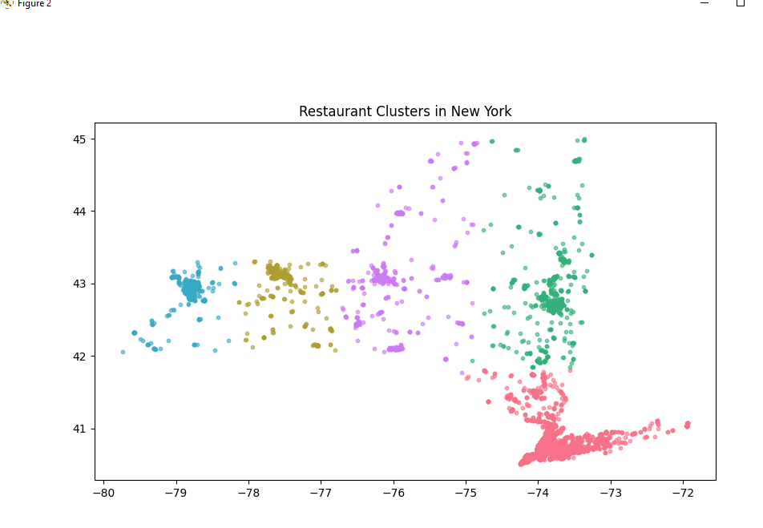

Slide 9
